Slide 1


Slide 2



08 February 2021
Turin, Italy
MATLAB
Leonardo AKTAS Kaan
Dept. Electronics and Telecommunications, Politecnico di Torino, Torino, Italy
This project has received funding from the European Union’s Horizon 2020 research and innovation Programme under grant agreement No XXX
Other Logo
Notes:
State of the art and Gap waveguide designs

Slide 3

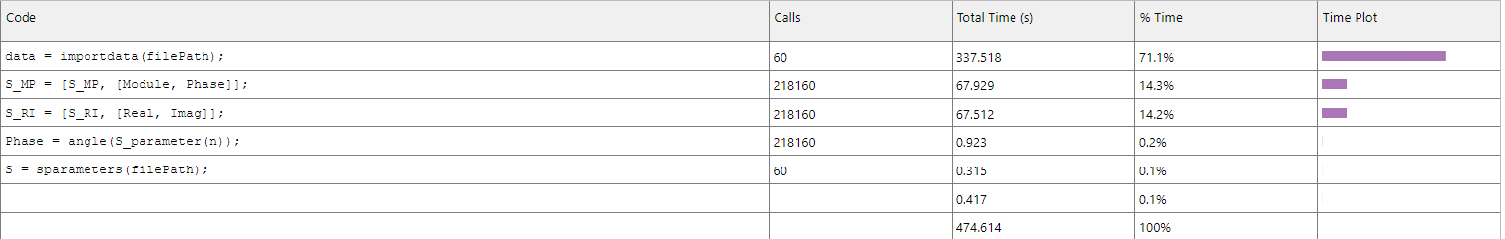
File reading optimisation
Most time consuming function
File reader : 71.1% of total time
S Matrix creation: 28.5% of total time
File path exemple: 'C:\Users\d105457\Documents\GitHub\MatlabOpt\DATA_SET\27 febbraio - PART1\set1\CSF_10_m1.s6p'
Notes:
123.585/138.065

Slide 4
File reading optimisation
Leonardo You can explain in here what you have done
Mostly how you have removed importdata and used sparameters function to read the files etc.
File path exemple: 'C:\Users\d105457\Documents\GitHub\MatlabOpt\DATA_SET\27 febbraio - PART1\set1\CSF_10_m1.s6p'
Notes:
123.585/138.065

Slide 5
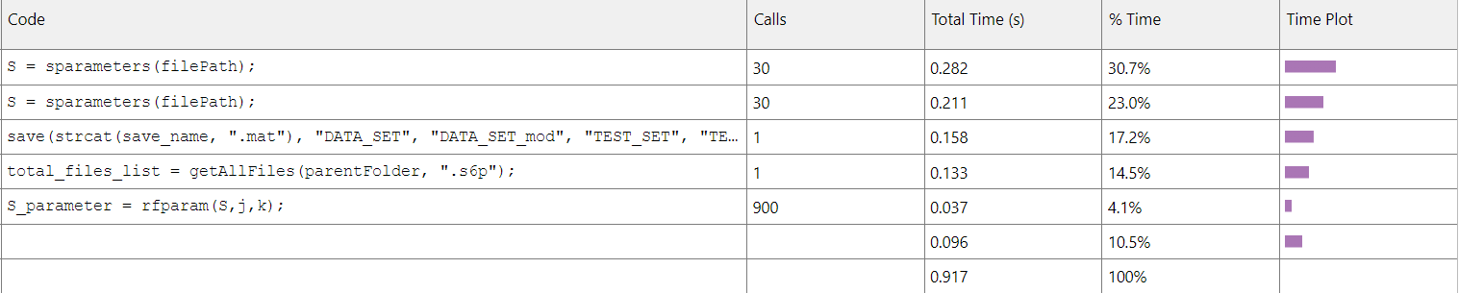
Script to Function transformation
Most time consuming function
File reader : 71.1% of total time
Speed is improved by 300 times by removing importdata and using sparameter class
Reason: textscan function is used in sparameters which is faster
File path exemple: 'C:\Users\d105457\Documents\GitHub\MatlabOpt\DATA_SET\27 febbraio - PART1\set1\CSF_10_m1.s6p'
Notes:
123.585/138.065

Slide 6
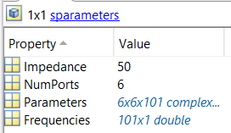
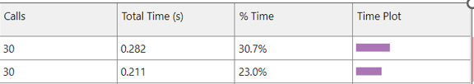

Alternative function to sparameters of RF toolbox
Class | sparameters
Structs | Impedance (unnecessary) Numports (unnecessary) Parameters (necessary) Frequencies (unnecessary)
Unnecessary data
Nonessential data checking and loops to find the beginning of S parameters
Struct increases memory usage
Notes:
123.585/138.065

Slide 7
S parameter optimisation

Slide 8
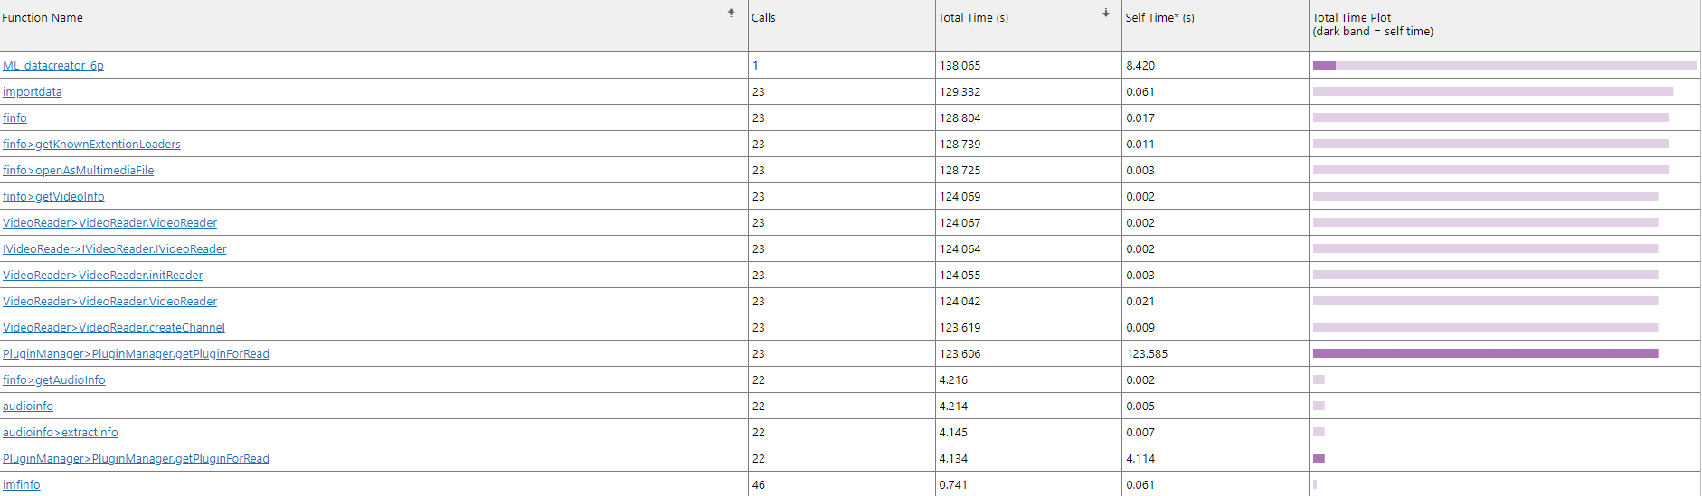
Script to Function transformation
Most time consuming functions
File reader : 89.5% of total time
ML_datacreator_6P script : 89.5% of total time
Notes:
123.585/138.065

Slide 9
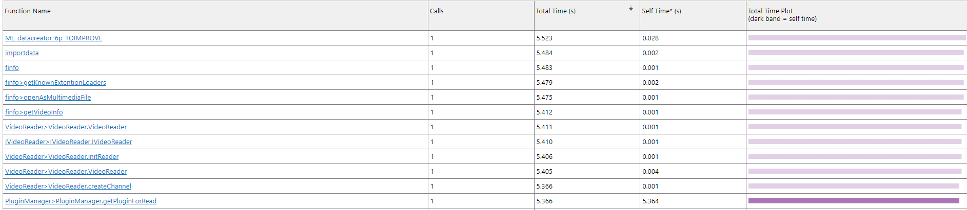
Script to Function transformation

